Slide 1
Nuclear Fuel Performance
NE-591-010
Spring 2021

Slide 2
Last Time
Wrapped up thermomechanics
Overviewed US fuel performance codes

Slide 3
Material Property Evolution

Slide 4
Pretty much everything we have learned so far, nothing changes once the fuel and cladding reach steady state

Slide 5
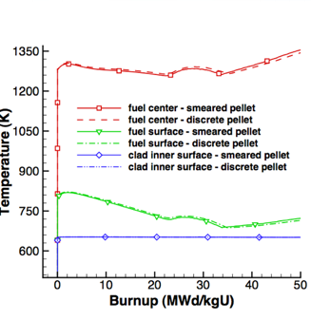
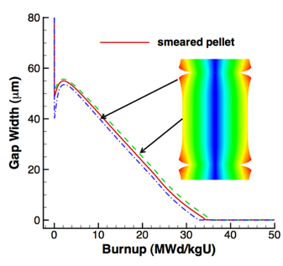
Fuel is dynamic!

Slide 6
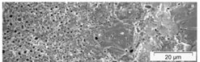
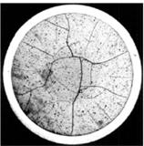
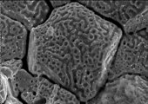
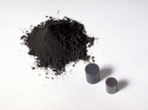

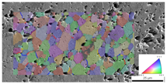
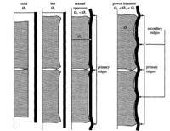
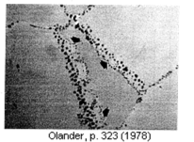
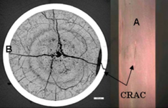
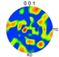
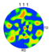
Property changes due to microstructure evolution during reactor operation must be considered
Insertion in reactor
Removal from reactor
Early life
Thermal expansion
Fracture
Point defect and fission gas generation
Fuel Densification
Mid Life
Point defect diffusion
Point defect clustering
Fission gas segregation to GB and voids
Bubble nucleation
Late life
Fission product swelling
Bubble percolation and fission gas release
Cladding creep
Fuel creep
Fuel failure
Pellet/cladding interaction
Cladding corrosion
Cladding fracture
Fuel Fabrication
Sintered UO²
Height 2 cm
Diameter 1 cm
~10 μm grain size
Density > 95%
Brohan 2000
From Pedro Peralta, ASU
Zinkle and Singh 2000
Santana et al. 2011

Slide 7
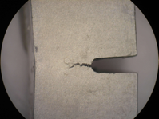
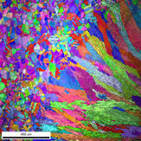
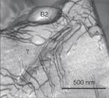
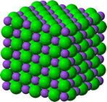
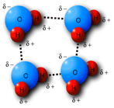
The properties and performance of a material are a result of factors across various length scales
Material properties and performance
Microstructure
Defect interactions
Crystal structure
Chemical bonds

Slide 8
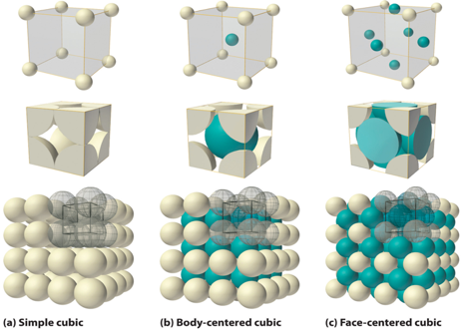
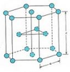
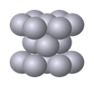
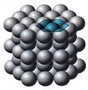
The crystal structure of a material is the shape of the ordered structure of the atoms
The atoms of many materials form an organized lattice, these are called crystalline materials. All reactor materials are crystalline.
The configuration of the atoms in the lattice impacts the properties of the material (density, thermal expansion coefficient, elastic modulus, etc.)
All major light water nuclear materials are either cubic or hexagonal
(d) Hexagonal close packed

Slide 9
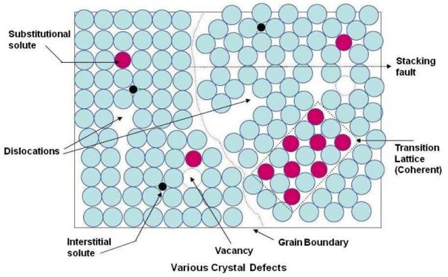
Crystalline materials
In crystalline materials, the lattices are not perfect, they have defects
Defects can be 0D, 1D, 2D, 3D
The interactions between defects seriously impact material properties and how they perform

Slide 10
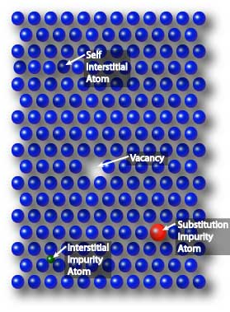
Point defects
Point defects (zero-dimensional defects) are lattice imperfections related to one or two lattice sites
There are several types of point defects
Vacancies
Self interstitial atoms (SIA)
Interstitial impurity atoms
Substitutional impurity atoms
Point defects control the mobility of atoms and, therefore influence all processes that depend on diffusion

Slide 11
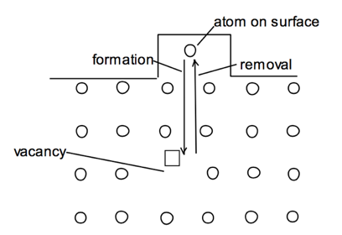
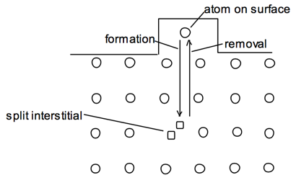
Point defects
Vacancies and interstitials form naturally in materials
Extra atoms can sit on a surface, creating a vacancy, or a surface can have a missing atom, creating a self interstitial atom (SIA)
We define the number of vacancies or interstitials in terms of a concentration
There exists an equilibrium concentration of point defects

Slide 12
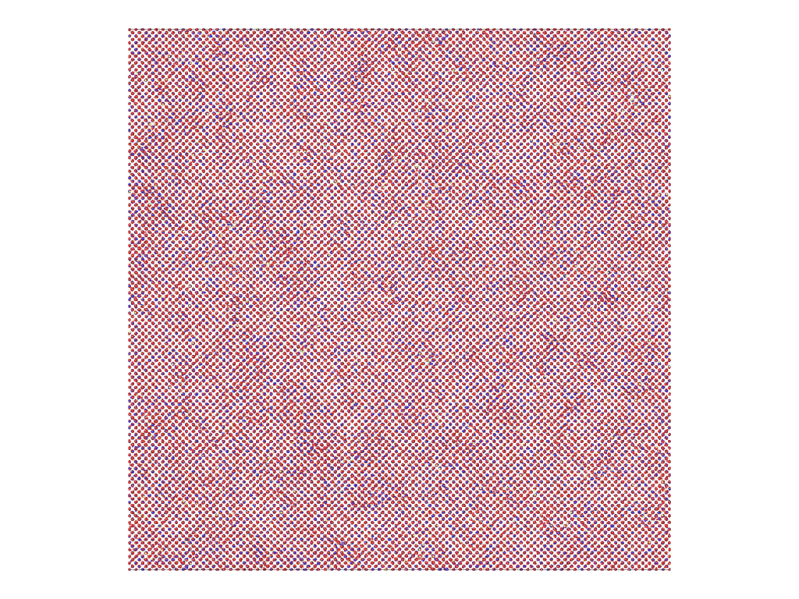
Radiation damage
Ionizing radiation can introduce defects into the crystal lattice, called radiation damage
PKA collisions create a collision cascade, which results in the generation of defects (point and clusters)

Slide 13
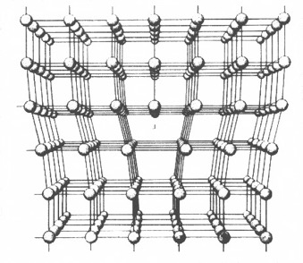
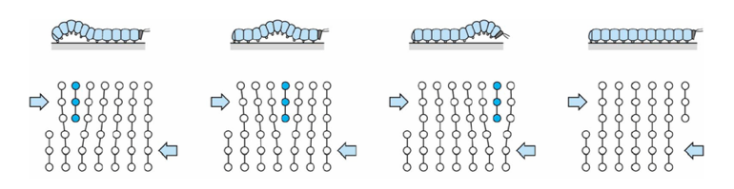
Dislocations are imperfections associated with a line of lattice sites (1D defect)
In a dislocation, an extra half plane of atoms is inserted into the lattice
When it moves, only a small number of bonds are broken at a time
Dislocation motion controls the plastic (permanent) deformation of crystalline materials

Slide 14
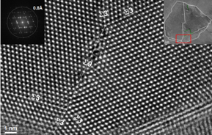
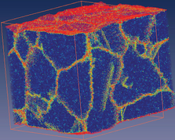
Grain boundaries
Materials are typically composed of various regions where the crystal lattice is oriented differently. These regions are called grains
When two grains meet, there is a plane of atoms that do not follow the crystal lattice called a grain boundary
Most crystalline materials are polycrystalline, not single crystal
High-res transmission eleectron microscopy can also show individual atoms (palladium)
www.knmf.kit.edu/TEM.php
Atomistic simulation of grain boundaries in 3D

Slide 15
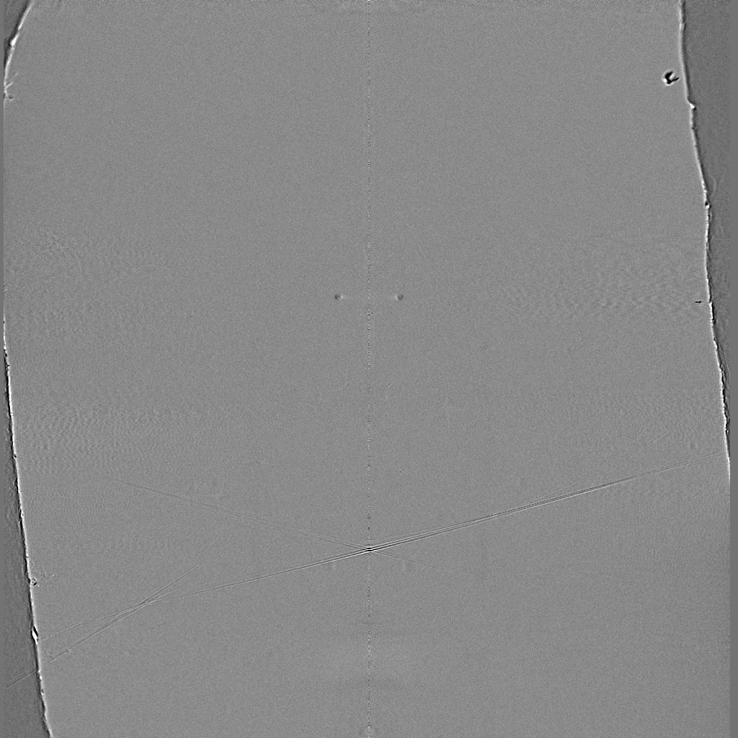
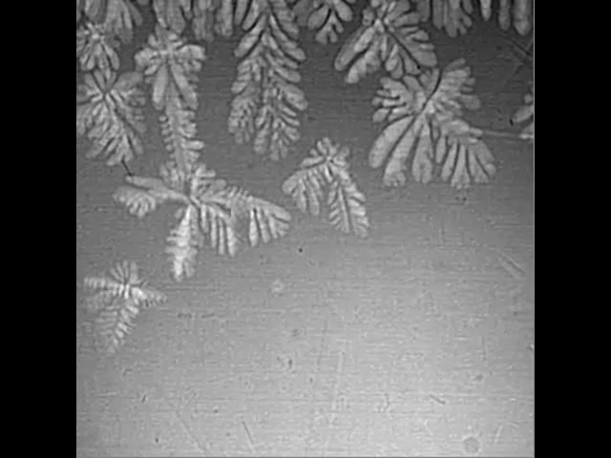
Metals are often cast, and polycrystals naturally form during casting

Slide 16
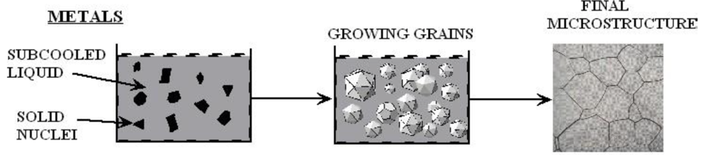
Polycrystals naturally form during casting
Solidification begins in different regions of the melt, each with a different orientation
Once the different regions meet, grain boundaries form between them

Slide 17
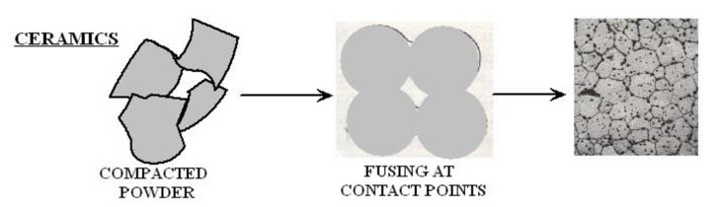
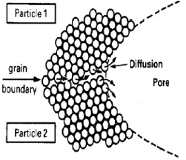
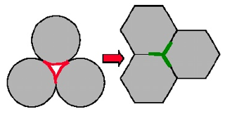
Ceramic sintering
Ceramics are typically sintered, and polycrystals also naturally form from sintering
In sintering, powders are compacted at high temperature
The particles are each oriented differently, and as the fuse, grain boundaries form
The differences between the grain orientations result in the grain boundary

Slide 18
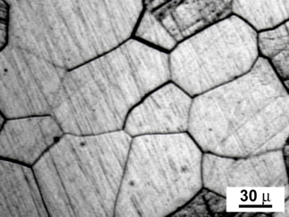
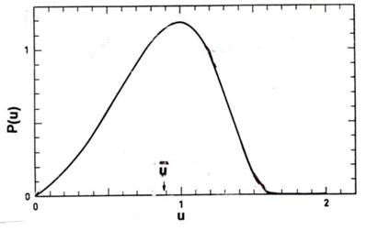
Distribution of grain sizes
In a polycrystal, there is also a distribution of grain sizes
Therefore, we commonly refer to the grain size distribution and the average grain size
The Hillert distribution is an analytical distribution for grain size
Real materials often vary from this behavior

Slide 19
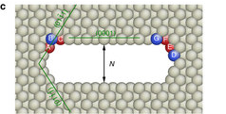
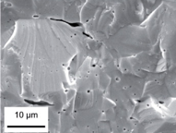
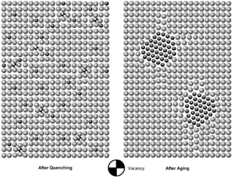
3D Defects
When point defects cluster, they form three dimensional defects
The energy of a point defects is reduced when several point defects cluster together
Larger clusters of vacancies are called voids
Clusters of impurity atoms are called precipitates

Slide 20
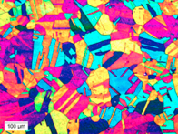
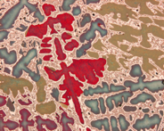
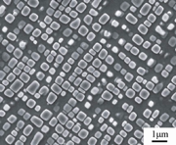
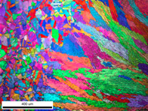
Microstructure
Material microstructure is the structure observable with 25x magnification
The microstructure includes grain structure, secondary phases, porosity, and more
The microstructure can strongly influence physical properties such as strength, toughness, ductility, hardness, corrosion resistance, high/low temperature behavior or wear resistance.
These properties in turn govern the application of these materials in industrial practice
Annealed Stainless Steel
Cast Bronze
Sintered UO2
Co-Al-W Superalloy
Friction stir welded stainless steel

Slide 21
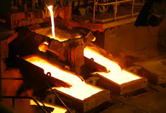
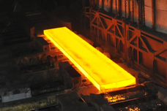
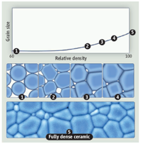
Material processing
The process we use to make a material has a huge impact on its microstructure and properties
Casting – manufacturing process in which a liquid material is poured into a mold and then allowed to solidify
Can be used to make complex shapes
The solidified microstructure typically has properties that are far from ideal
Sintering – Forming a solid from a powder using heat and/or pressure without melting the material
Applicable to metals and ceramics
Difficult to obtain a material that is fully dense
Used to make fuel pellets
Heat treatment – heating or cooling a material to extreme temperatures to get desired microstructure and properties
Used to control the rate of microstructure change, including diffusion, grain growth, or phase change
Use on many types of materials (metals, ceramics, glasses)

Slide 22
Summary
Even during steady state operation, fuel and pellet conditions change with time due to microstructure evolution
Atoms in the fuel and cladding materials are arranged in a crystal lattice
The crystal lattice is never perfect; it has defects
Point defects include vacancies, interstitials, and impurity atoms
Dislocations are line defects
Grain boundaries are planar defects
Voids and precipitates are volume defects
All materials have defects, radiation damage causes many more defects
Microstructure can be tailored through processing

Slide 23
UO2 Radiation effects

Slide 24
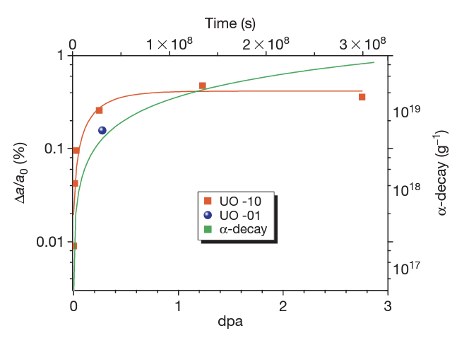
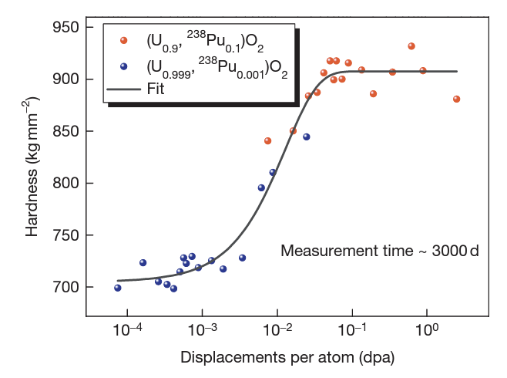

Slide 25
High Burnup Structure (HBS)
When thermal recovery is not sufficiently efficient (at lower temperatures), the accumulation of defects at high burnup can lead to the instability of the crystalline structure, initiating a restructuring driven by the energy stored in the material
In UO2, grains subdivide (to 100-500 nm size) and a densely porous structure is formed

Slide 26
High Burnup Structure (HBS)
The increase of the relative porosity volume degrades the material conductivity and reduces the mean grain size
On the other hand, the intragranular irradiation defect-cleaning improves the fuel intrinsic thermal conductivity
Fission gas in HBS bubble is retained, not released

Slide 27
Fuel chemistry

Slide 28

Fuel Chemistry
UO₂ is an ionic compound that must have balanced charges
What is the charge of a typical oxygen ion?
O²⁻
Uranium valance states
Possible: U³⁺, U⁴⁺, U⁵⁺, U⁶⁺
Most stable: U⁴⁺, U⁵⁺, U⁶⁺
Beyond UO2, can have U4O9, U3O8, UO3
The structure is very stable all the way up to the melting temperature and down to extremely low temperatures, even with irradiation damage
There is space in the uranium lattice that can accommodate fission products

Slide 29

O/M ratio
The ratio of oxygen to uranium metal (O/M ratio) can vary
This is the stoichiometry
The homogeneity range of uranium dioxide extends to both hypo- and hyperstoichiometric compositions in oxygen
The minimum and maximum oxygen contents in the dioxide correspond to the compounds with the formula of respectively UO_{1.67} at 2720 K and UO_{2.25} at approximately 2030 K
Will the O/M ratio go up or down during reactor operation?
It is complicated, because of the formation of fission products that also react with the oxygen, and O interaction with Zr cladding

Slide 30

Excess O
The crystal structure of UO₂ can accommodate extra oxygen
Excess oxygen resides at interstitial locations
Oxygen in neighboring sites is displaced
Cation valence increases to maintain electrical neutrality
Fuel fabricated to be nearly stoichiometric; i.e., UO2.00± because:
It is the most stable
It has the highest melting temperature
[after Olander, 1976]

Slide 31

Incorporation of Fission Products
As fission products form, the valence state of the uranium can change
Typical valence of soluble fission products is M³⁺
The uranium valence state changes to compensate
Oxygen liberated by fission
Fission products produced with M³⁺ valance state incorporated in fuel lattice
Uranium oxidizes from U⁴⁺ to U⁵⁺ or U⁶⁺ to maintain local electrical neutrality

Slide 32


Oxygen potential
The oxygen potential is a measure of how free the oxygen is to escape/move around
Oxygen potential is defined as:
or, equivalently:
With = Chemical potential of oxygen in solution
= Gibbs free energy of gaseous oxygen at temperature T and a standard pressure (1 atm)
It is possible to determine the stoichiometry from the oxygen potential

Slide 33


Oxygen potential
The oxygen potential changes during irradiation, indicating change in the O/M ratio
Oxygen potential changes during irradiation due to
Liberation of oxygen by fission; Generation of fission products; Conversion of uranium to plutonium; Reaction of oxygen with U, Pu, fission products, and cladding
Oxygen potential across pellet radius observed to be constant at the approximate value of Mo/MoO₂ reaction (from calculations)
Mo serves as a buffer to the O potential, or a means of inferring what the oxygen potential may have been in the fuel from PIE
Oxygen potential is low near the cladding, because the oxygen enters the cladding

Slide 34

Fuel Stoichiometry/Properties
The stoichiometry of the fuel directly impacts the fuel performance
Stoichiometry impacts
Melting temperature
Thermal conductivity
Processes dependent on diffusion
Grain growth
Fission gas release
Creep
Chemical state and behavior of fission products
Chemical reactions at inner cladding surface
Thermal conductivity is highest for stoichiometric UO2

Slide 35


Fuel Stoichiometry/Properties
The lattice constant of the material decreases with increasing stoichiometry
The vacancy formation energy also changes with stoichiometry

Slide 36

Fuel Stoichiometry/Properties
Fission product | UO_{1.97} | UO₂ | UO_{2.03}
Xe | 3.88 eV | 3.88 ev | 2.61 eV
Cs | 1.7 eV | -0.04 eV | -3.29 eV
Sr | -3.71 eV | -6.03 eV | -9.55 eV
The solution energy of Xe, Cs, and Sr in UO₂ depends on stoichiometry as well
The coefficient defining Xe diffusion also changes with stoichiometry
Though stoichiometry matters, most fuel performance codes ignore it

Slide 37
Fuel Chemistry Summary
UO₂ has a cubic fluorite structure that is very stable
The charges are balanced with a U⁴⁺ valence state
However, the ratio of oxygen to uranium can change. We call this the stoichiometry and abbreviate it as O/M ratio
The O/M ratio changes during reactor operation, but it is complicated
The O/M ratio impacts many properties of the fuel

